Slide 1


https://github.com/MOElkateb9/Orange-Tasks/tree/main/final%20ML%20project
ODC – ML Project
Ziad Mustafa
Yaseen Abdulghany
Mohamed Elkhateb
Project on GitHub

Slide 2
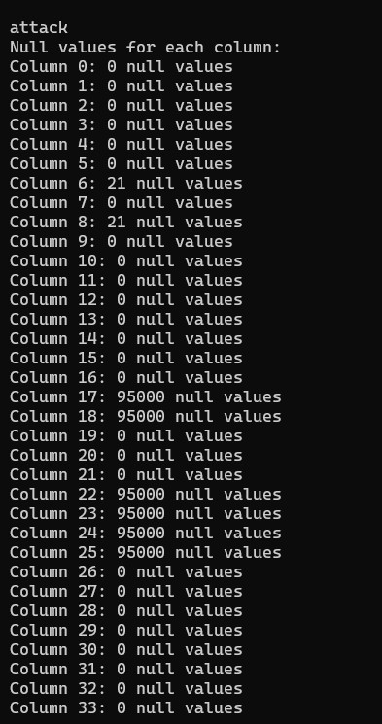
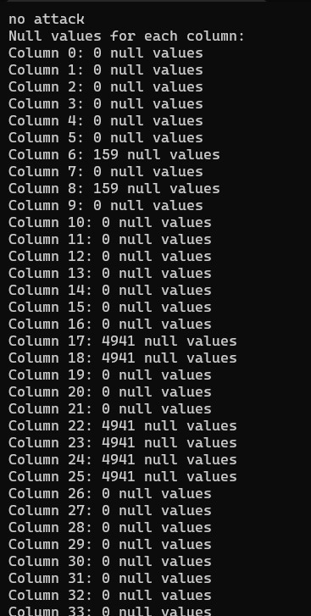
Explore NULL values

Slide 3
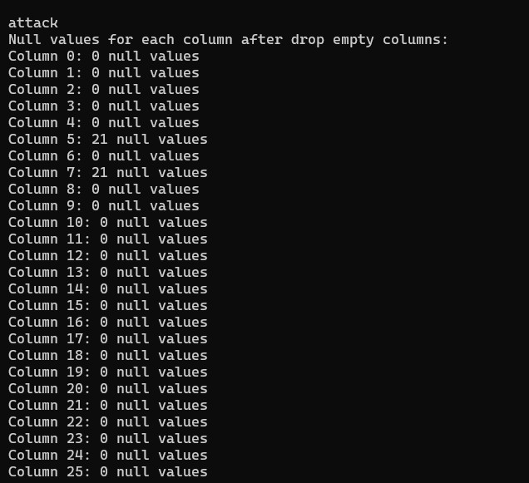
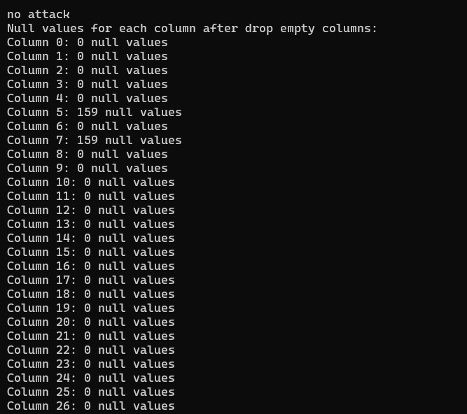
Explore NULL values
After drop empty columns

Slide 4
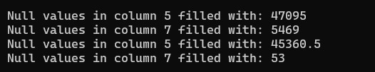

Explore NULL values
Replace Null values with the medina
Find duplicated values

Slide 5
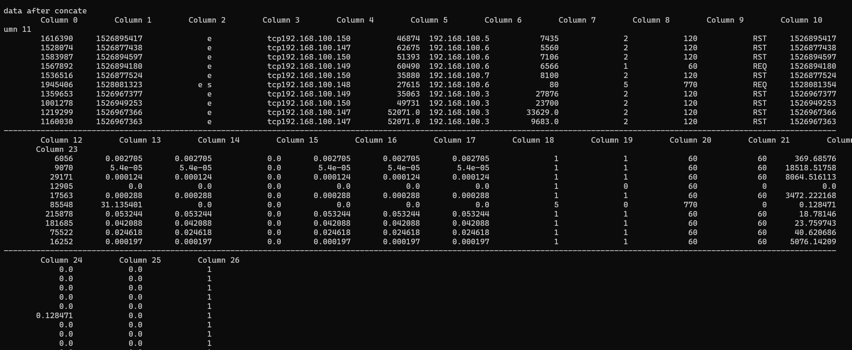
After concat the two datasets (attack – no attack)

Slide 6
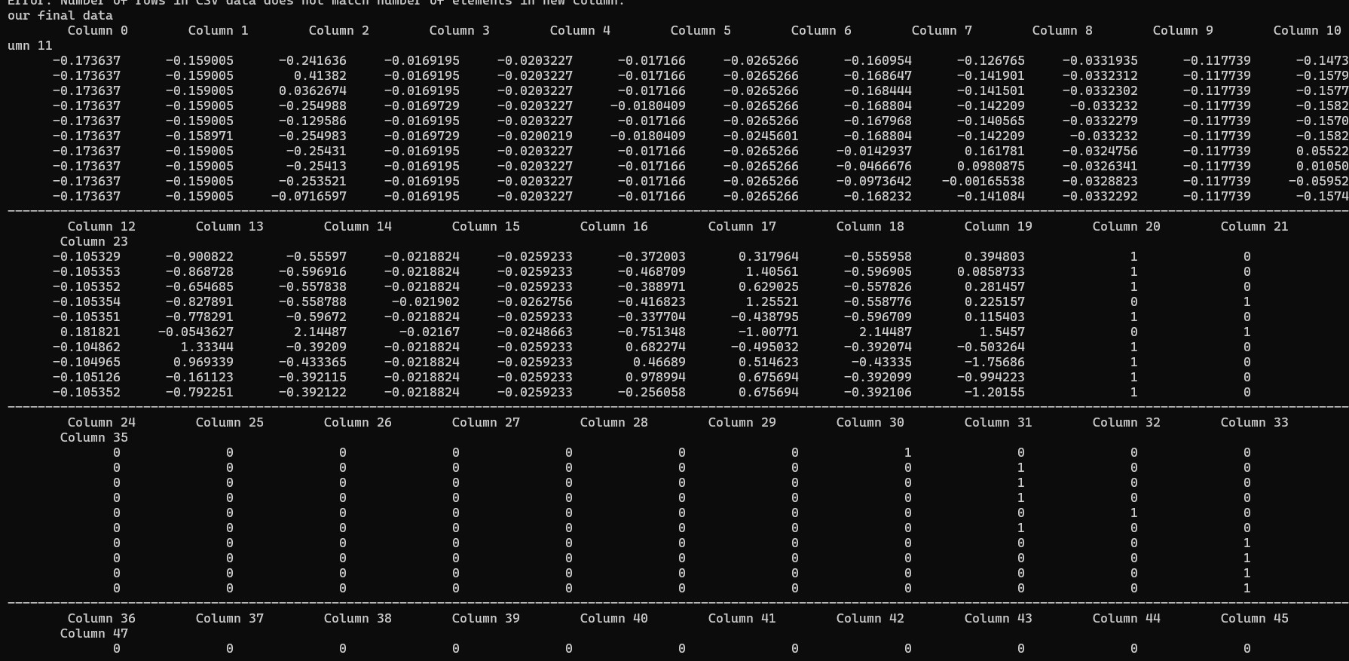
After Scaling – One Hot Encoding

Slide 7
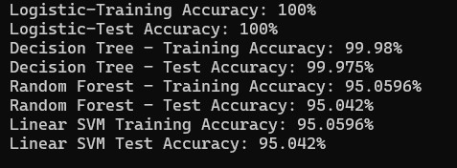
MLPack -- Models

